Slide 1

Machine learning in space physics Savvas Raptis Space Physics I KTH Royal Institute of Technology 10 / 10 / 2022 | 13:00 – 15:00

Slide 2
Introduction to Neural Networks & Applications in Space Physics Savvas Raptis Space Physics I KTH Royal Institute of Technology 10 / 10 / 2022 | 13:00 – 15:00

Slide 3
What is machine learning & A.I ? (1)
Making the computer “learn” without being explicitly programmed

Slide 4


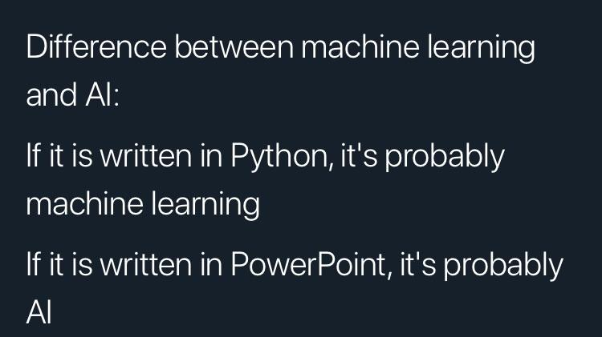
What is machine learning & A.I ? (2)
AI (Artificial Intelligence) : A term most of the times used to draw attention (at least for the moment).
ML (Machine Learning) : A program designed to “learn” something based on a set of rules and/or data.

Slide 5

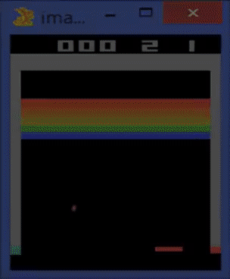
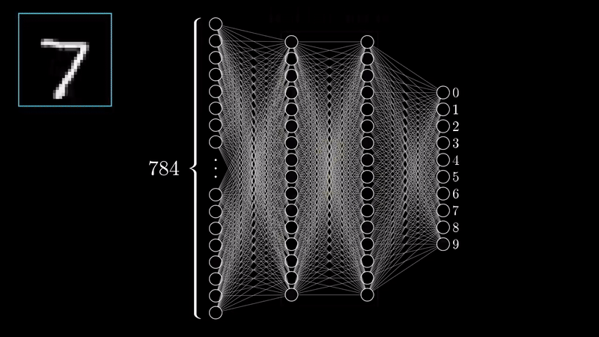
Different categories of Machine Learning
Supervised learning : Given Input and Output - learn the mapping by minimizing an error between the initially random output with the given output. Obtaining a relation.
Unsupervised Learning: Given Input but not output - Either find features or discover patterns.
Reinforcement learning: No data needed, just a value that we want to maximize (e.g. score in game) and a set of actions/environment. The goal is to find a sequence of actions that maximizes the reward.

Slide 6
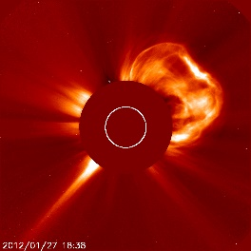
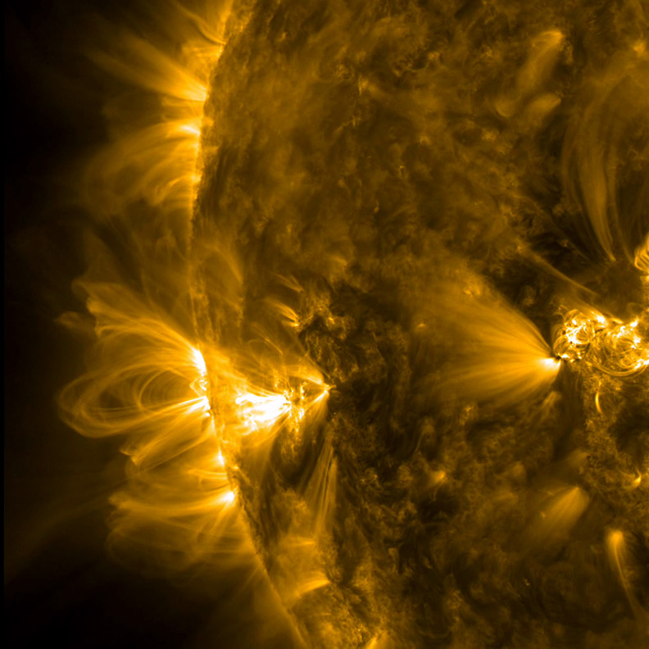
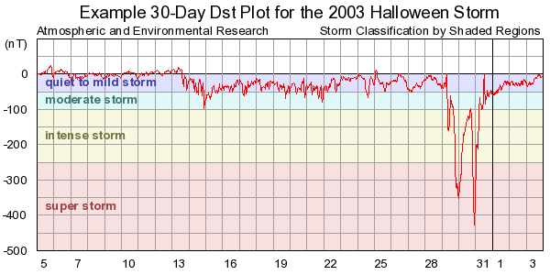
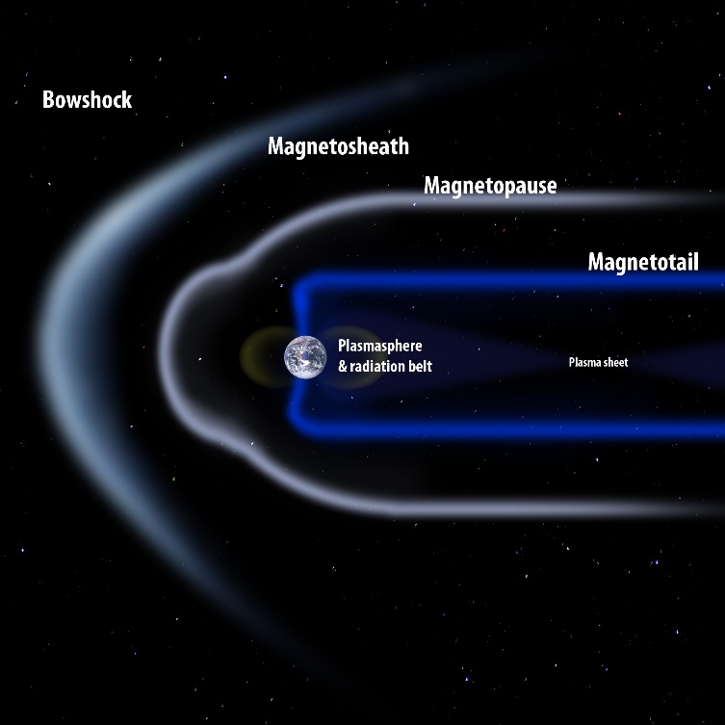
Relevance to Space Physics
Can we predict SEPs
(Solar Energetic Particles) ?
Can we reconstruct coronal loops?
Can we predict CMEs?
Can we predict Geomagnetic storms?
Can we classify plasma environments?

Slide 7
Supervised Learning
using
Neural Networks

Slide 8

TLDR version
https://xkcd.com/1838/

Slide 9
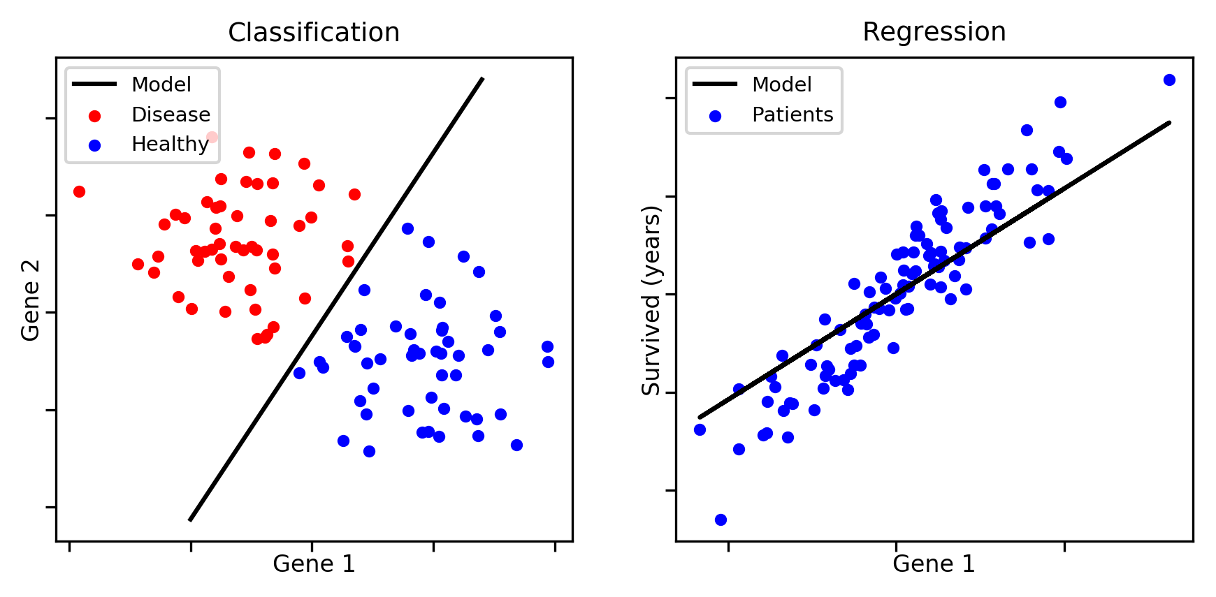
Type of Machine Learning Problems

Slide 10
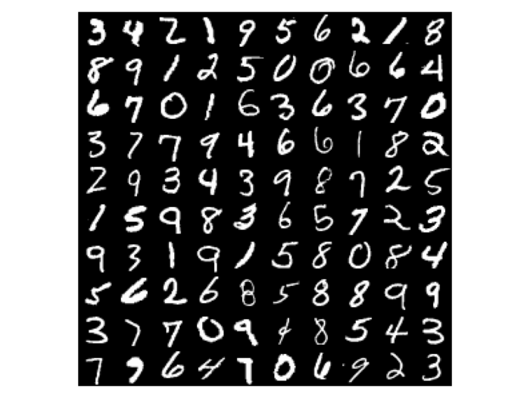
Let’s think of a problem (classification)
Data: Thousands of labeled numbers 1-9
Problem: Can we make a model that given the image can recognize the number ?
(one) Solution: Neural Networks!

Slide 11

Another problem to think of (regression)
Data: characteristic of a house (e.g., # of rooms)
Problem: What should the price be ?
(one) Solution: Neural Networks!

Slide 12
Outline
How to understand Neural Network modeling:
Concept (basic principles) & Building (what are the components?)
Train (How does it learn?)
Evaluate (Did it really learn anything?)

Slide 13
Outline
How to understand Neural Network modeling:
Concept (basic principles) & Building (what are the components?)
Train (How does it learn?)
Evaluate (Did it really learn anything?)

Slide 14
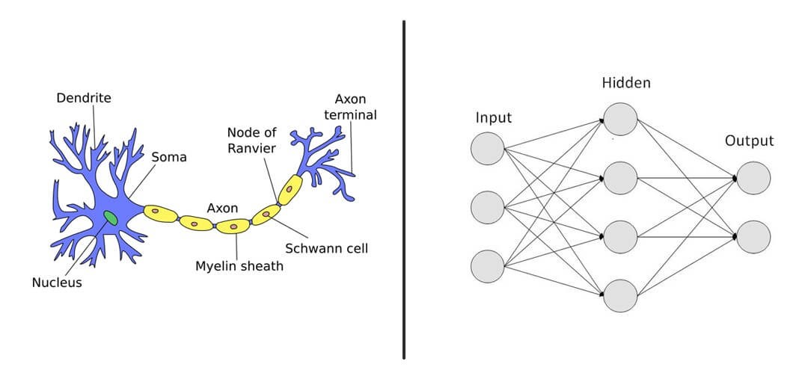
Biological vs Artificial Neural Networks
source: https://medium.com/@abhyudayj.isme1820/neural-networks-42b34deacc1b

Slide 15
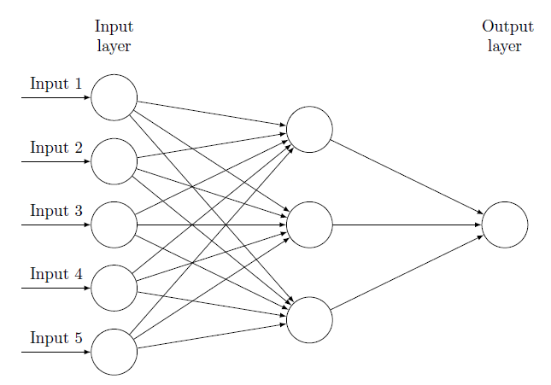
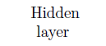
Neural Networks
Neuron
Let’s see what happens here!!
Ιnput/Output pairs
e.g.
Output = Price of house
Input1 = Square meters
Input2 = # rooms
Input3 = Proximity to center
Input4 = Age it was built
...
Output

Slide 16
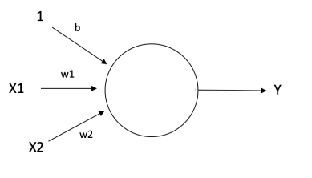
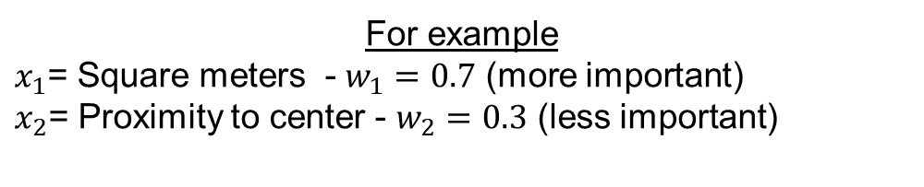
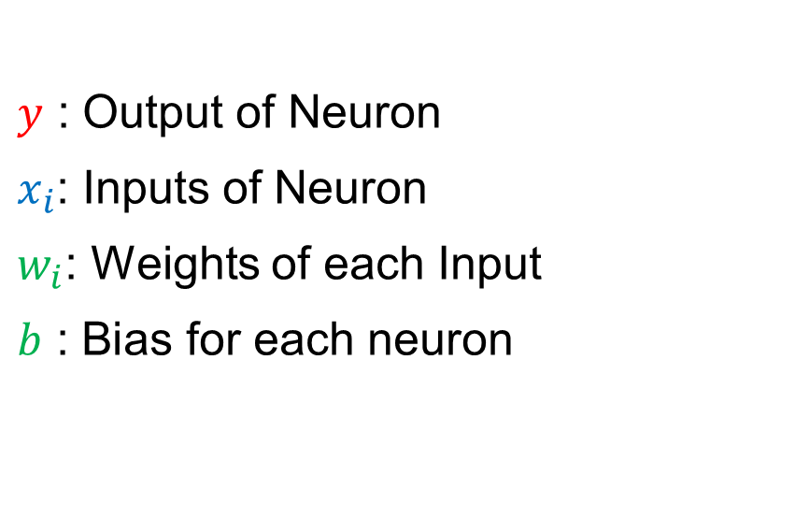


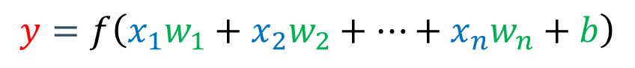
A Neural Network Input and Output
$y$ : Output of Neuron
$x_{i}$: Inputs of Neuron
$w_{i}$: Weights of each Input
$b$ : Bias for each neuron
$$y=f\left(x_{1}w_{1}+x_{2}w_{2}+…+x_{n}w_{n}+b\right)$$
Random Numbers
$$\text{Input}$$
$$Output$$
Let’s go there!
For example
$x_{1}$= Square meters - $w_{1}=0.7$ (more important)
$x_{2}$= Proximity to center - $w_{2}=0.3$ (less important)

Slide 17
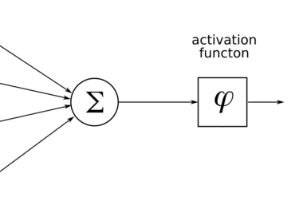
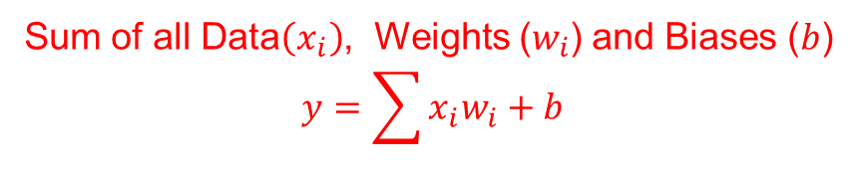
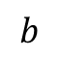
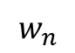
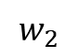
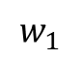
Inside the Neuron
$$b$$
$$w_{1}$$
$$w_{2}$$
$$w_{n}$$
Sum of all Data$\left(x_{i}\right)$, Weights ($w_{i}$) and Biases ($b$)
$$y=\sum{x_{i}w_{i}+b}$$

Slide 18

Activation Function
$$b$$
$$w_{1}$$
$$w_{2}$$
$$w_{n}$$
Apply $f\left(y\right)$ depending on goal

Slide 19
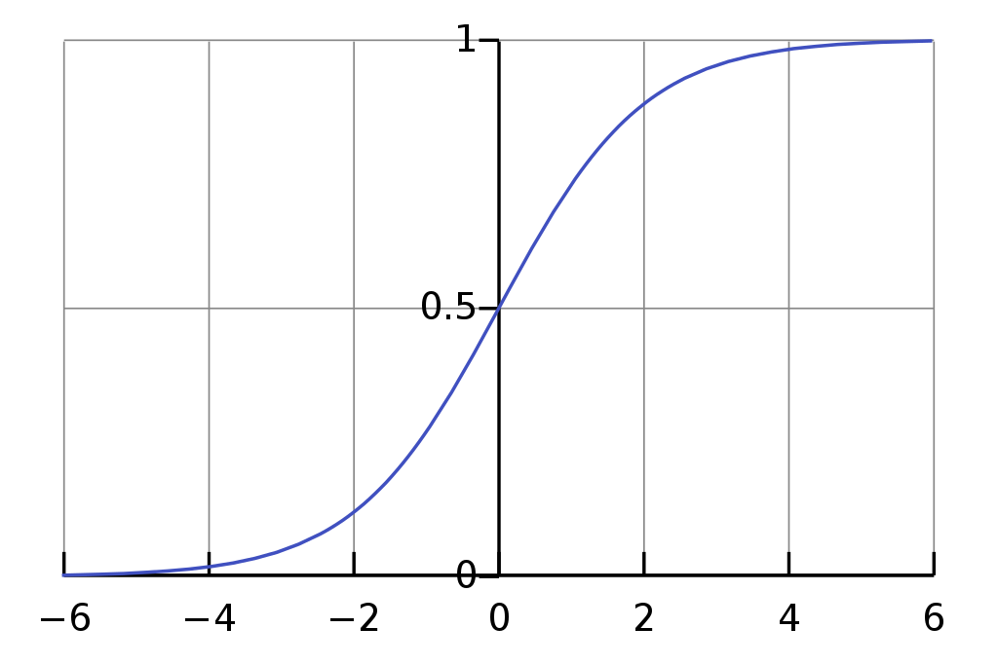
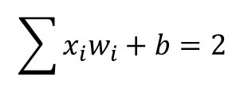
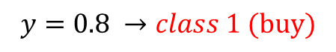
Activation function Examples
Goal: Classification (e.g., 0/1)
e.g. Should I buy the house?
Yes (class 1)
No (class 0)
$$\sum{x_{i}w_{i}+b}=2$$
$$y=0.8 →class 1 (buy)$$

Slide 20
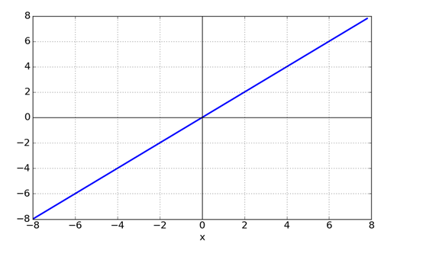
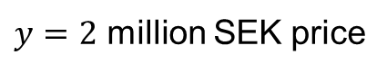
Activation function Examples
Goal: Regression (Continuous value)
e.g. How many million SEK will a house cost ?
$$\sum{x_{i}w_{i}+b}=2$$
$y=2$ million SEK price

Slide 21
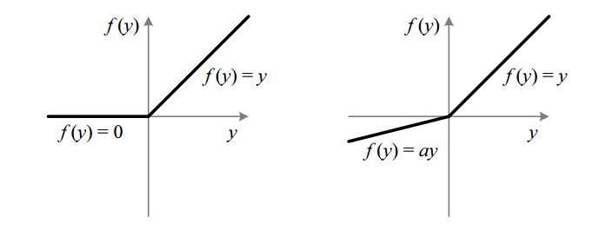
Hidden layer activation functions
Goal: Add complexity to our mapping
Rectified Linear Units (ReLU)
LeakyReLU
Notes:
(combine the different inputs in a non-linear fashion)

Slide 22
Question time!
What do we know so far ?

Slide 23
Neural Networks
Output

Slide 24
Neural Networks
We put data here
Random parameters here (weights/bias)
Some activation function, depends on our goal
Output
We know output = supervised learning
We sum all the inputs with their weights when they go to a neuron!

Slide 25
Outline
How to understand Neural Network modeling:
Concept (basic principles) & Building (what are the components?)
Answer: ….
Train (How does it learn?)
Evaluate (Did it really learn anything?)

Slide 26
Outline
How to understand Neural Network modeling:
Concept (basic principles) & Building (what are the components?)
Answer: Yes! We know that now! We have a randomly parametrized model….. But ok, then what ? It should just spit out random results now right ?
Train (How does it learn?)
Evaluate (Did it really learn anything?)

Slide 27
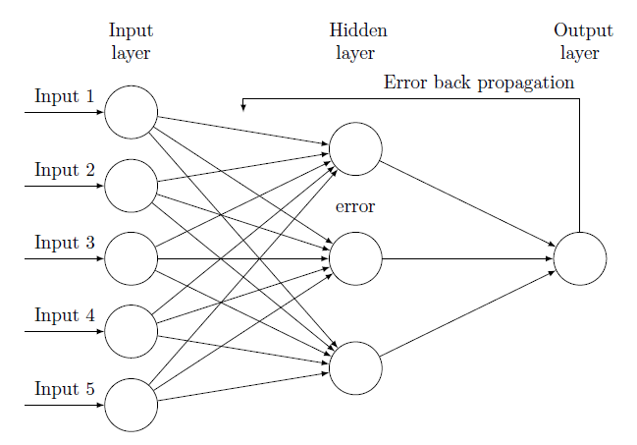
Neural Networks & Backpropagation
Output
Random parameters = random result
Error back propagation = change parameters based on data = modeling

Slide 28
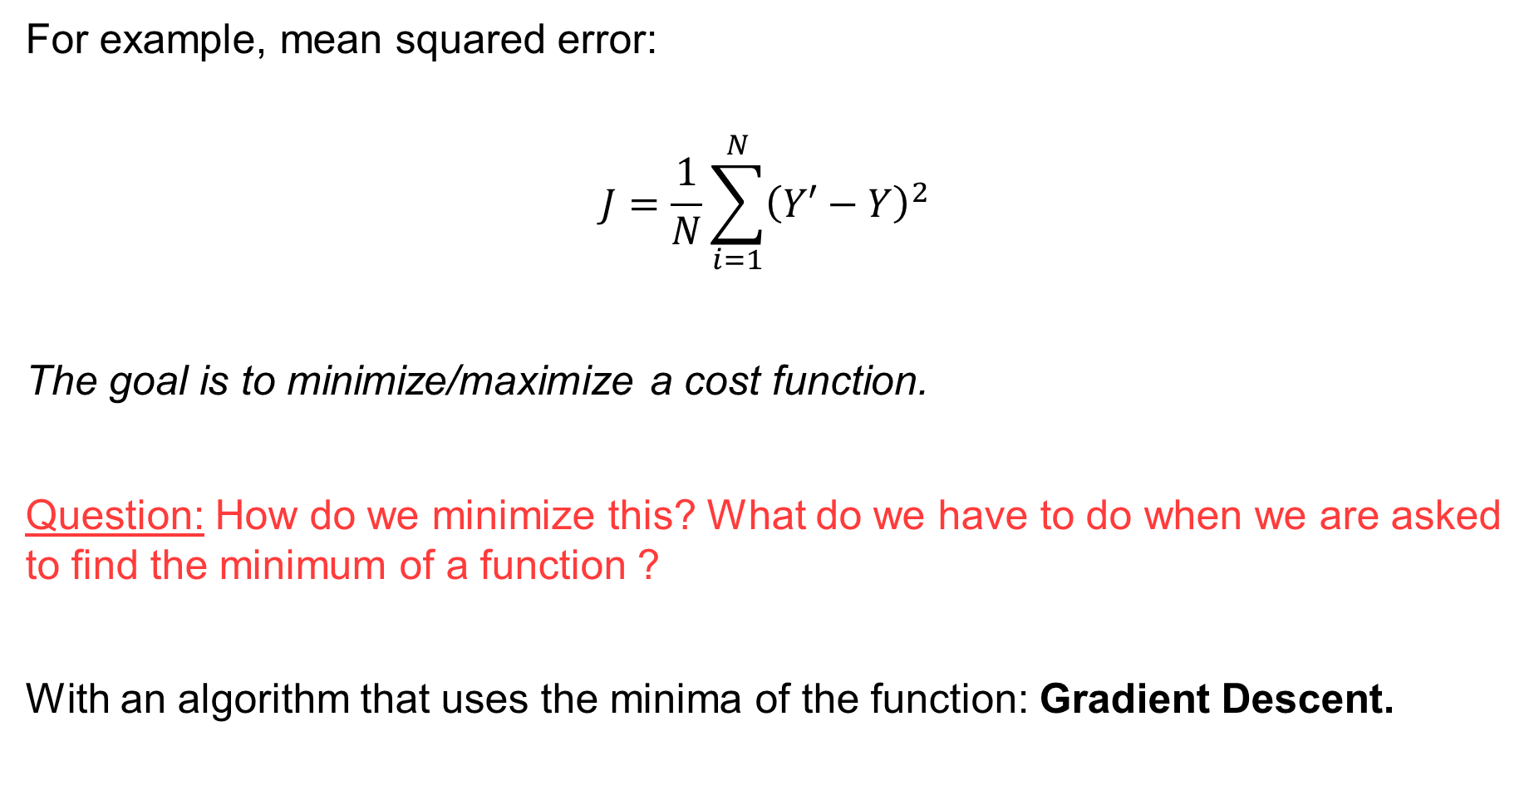
Cost (error) function
For example, mean squared error:
$$J=\frac{1}{N}\sum_{i=1}^{N}{{\left(Y′−Y\right)}^{2}}$$
The goal is to minimize/maximize a cost function.
Question: How do we minimize this? What do we have to do when we are asked to find the minimum of a function ?
With an algorithm that uses the minima of the function: Gradient Descent.
Output (initially random, since $w,b$ are random)
desired output (known)

Slide 29
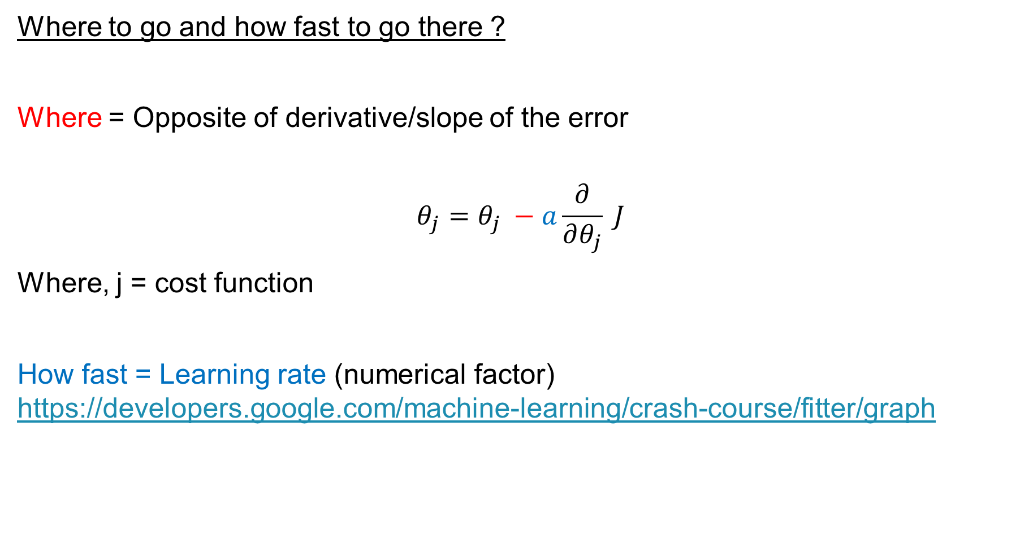
2 things we care about
Where to go and how fast to go there ?
Where = Opposite of derivative/slope of the error
$$θ_{j}=θ_{j} −a\frac{∂}{∂θ_{j}} J$$
Where, j = cost function
How fast = Learning rate (numerical factor) https://developers.google.com/machine-learning/crash-course/fitter/graph

Slide 30
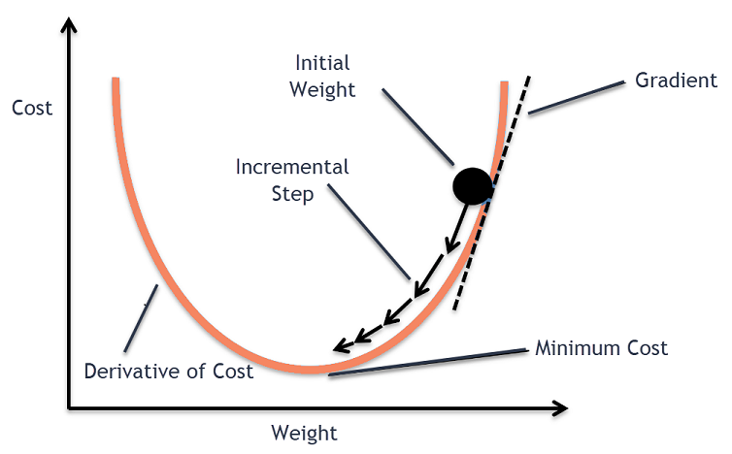

Error Back Propagation (Gradient Descent)
Automatically done by “optimizers”
(learning rate)
Back-propagation = calculating the derivatives.
Gradient descent = Descending through the gradient to change parameters.

Slide 31
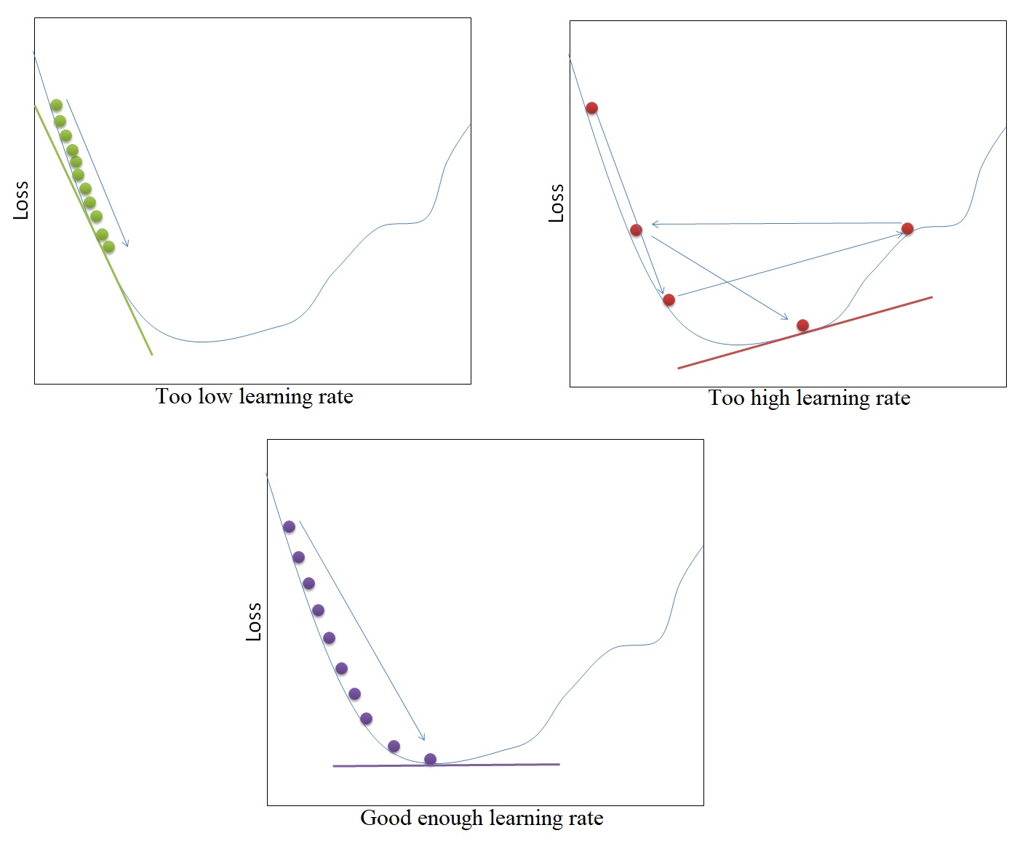
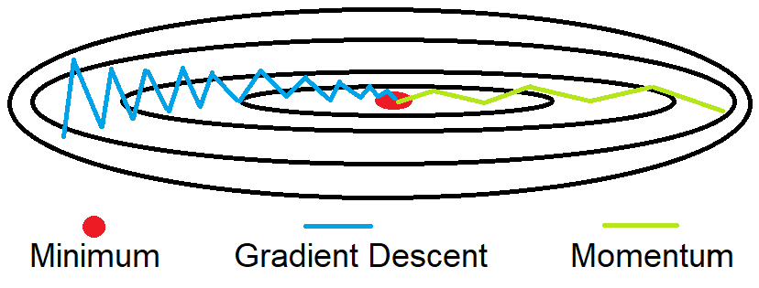
Why Optimizers? (learning rate + momentum)
Source: https://www.andreaperlato.com/aipost/gradient-descent-with-momentum/

Slide 32
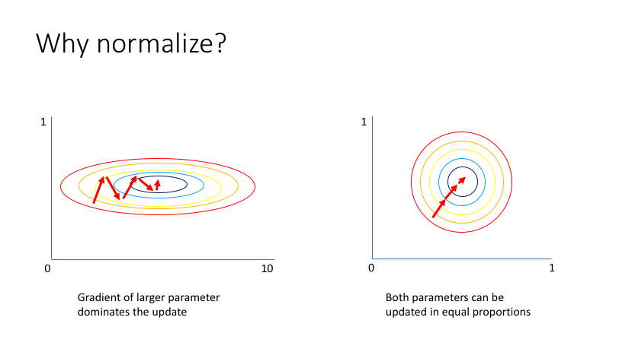
Normalization of data – Features
e.g.,
Number of rooms
[0 … 5]
Square meters
[0 … 300]

Slide 33
Outline
How to understand Neural Network modeling:
Concept (basic principles) & Building (what are the components?)
Answer: Yes! We know that now! We have a randomly parametrized model….. But ok, then what ? It should just spit out random results now right ?
Train (How does it learn?)
Answer: …
Evaluate (Did it really learn anything?)

Slide 34
Outline
How to understand Neural Network modeling:
Concept (basic principles) & Building (what are the components?)
Answer: Yes! We know that now! We have a randomly parametrized model….. But ok, then what ? It should just spit out random results now right ?
Train (How does it learn?)
Answer: Now we calculate the derivative of the error and we change the parameters of the network. Sure… But how do we test that thing ? I mean… It learned something that we explicitly trained. But everyone can do that… is it smart enough to deal with brand new information ?
Evaluate (Did it really learn anything?)

Slide 35
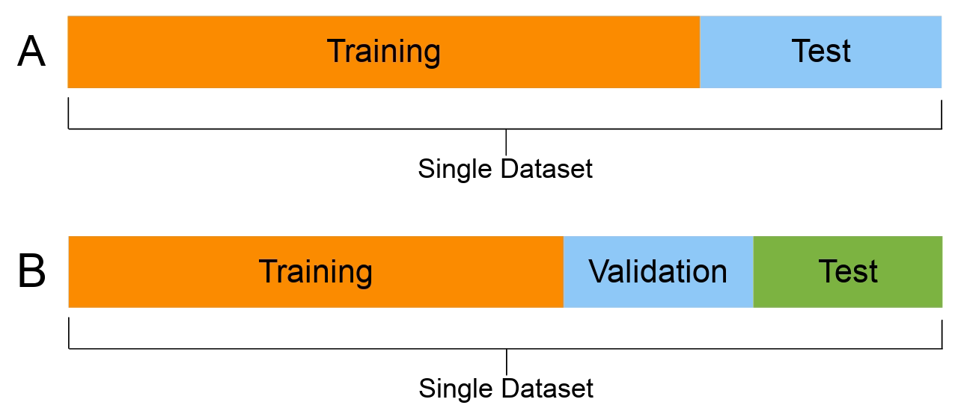
Train – Test – Validation sets
Question How do we evaluate the model now ??
1 “epoch” = 1 time training data have been used.
learn the model
e.g. optimize #neurons
evaluate

Slide 36

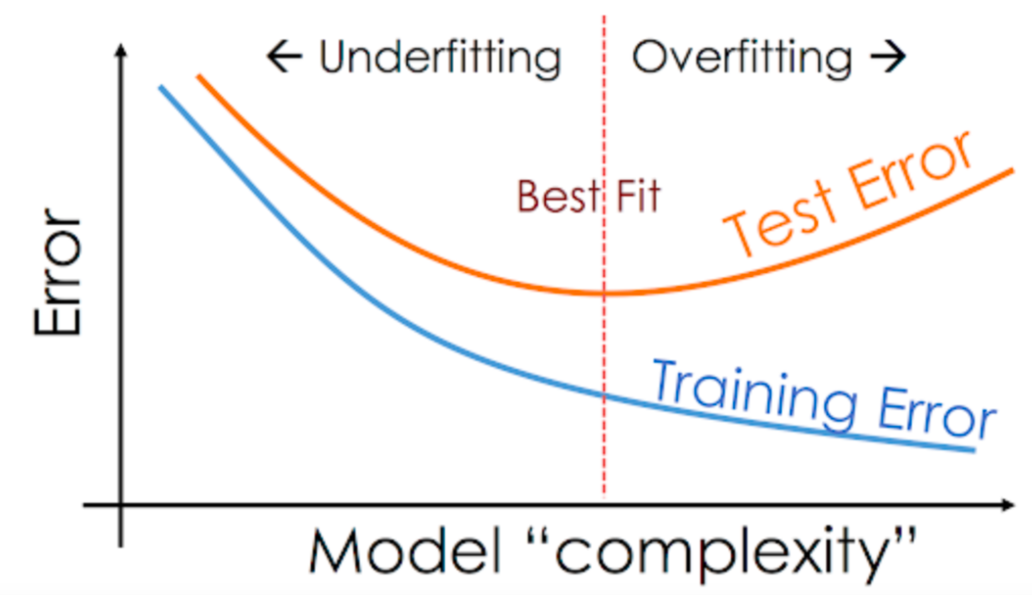
Overfitting

Slide 37
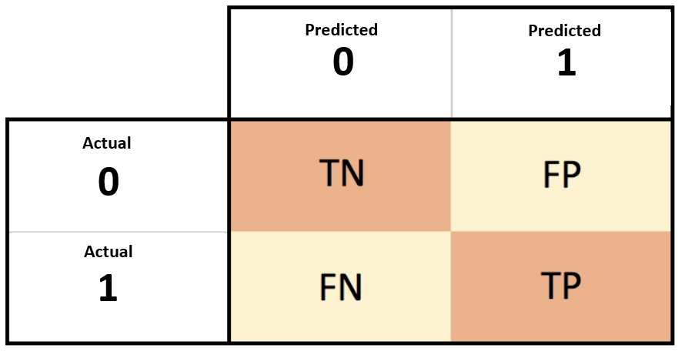
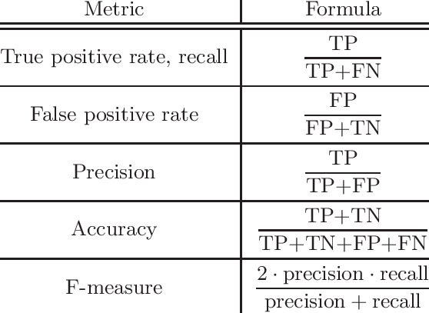
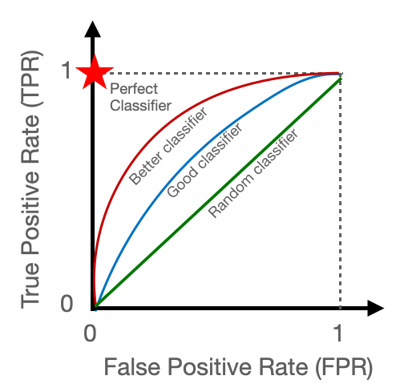
Evaluation Metrics (Classification)

Slide 38
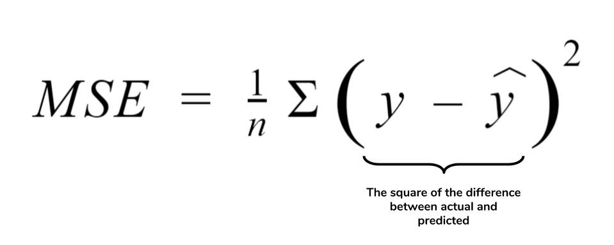
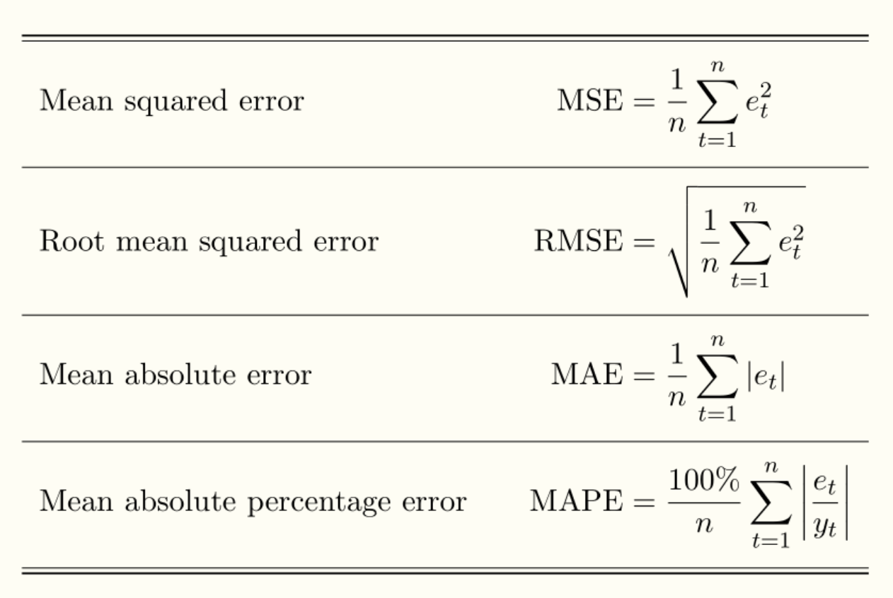
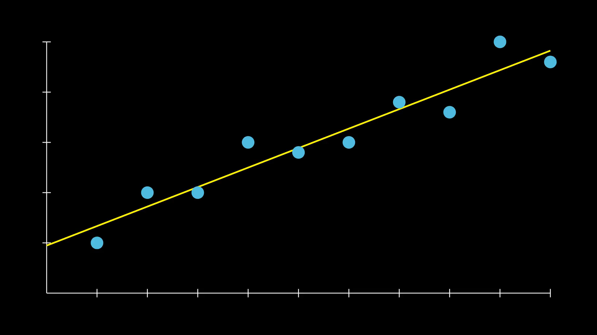
Evaluation Metrics (Regression)
Source: https://gist.github.com/thomasnield

Slide 39
Outline
How to understand Neural Network modeling:
Concept (basic principles) & Building (what are the components?)
Answer: Yes! We know that now! We add a lot of stuff, to a randomly parametrized model….. But ok, then what ? It should just spit out random result now right ?
Train (How does it learn?)
Answer: Ok Ok, we got it. Now we calculate the derivative and by comparing the initially random output to the one we wanted, we change the parameters of the network. Sure… But ok, how do we test that thing ? I mean… It learned something that was taught. But everyone can do that… is it smart enough to deal with brand new information ?
Evaluate (Did it really learn anything?)
Answer: …

Slide 40
Outline
How to understand Neural Network modeling:
Concept (basic principles) & Building (what are the components?)
Answer: Yes! We know that now! We add a lot of stuff, to a randomly parametrized model….. But ok, then what ? It should just spit out random result now right ?
Train (How does it learn?)
Answer: Ok Ok, we got it. Now we calculate the derivative and by comparing the initially random output to the one we wanted, we change the parameters of the network. Sure… But ok, how do we test that thing ? I mean… It learned something that was taught. But everyone can do that… is it smart enough to deal with brand new information ?
Evaluate (Did it really learn anything?)
Answer: Ok, so we put data, we change the parameters based on these and then we test with different data to see if the model is smart enough to pick the correct answer. Cool! Then we use different metrics to quantify what happened.

Slide 41
A Trained Neural Network
*Video Courtesy: 3Blue1Brown (Check him on YouTube!)

Slide 42
Play time
http://playground.tensorflow.org
We can try to “stir the pile” with:
Extra input
Extra νeurons
Extra layers

Slide 43
But wait, there is more !
See anything weird ?
28 x 28 image
Hint 2
Hint
*Video Courtesy: 3Blue1Brown (Check him on YouTube!)

Slide 44
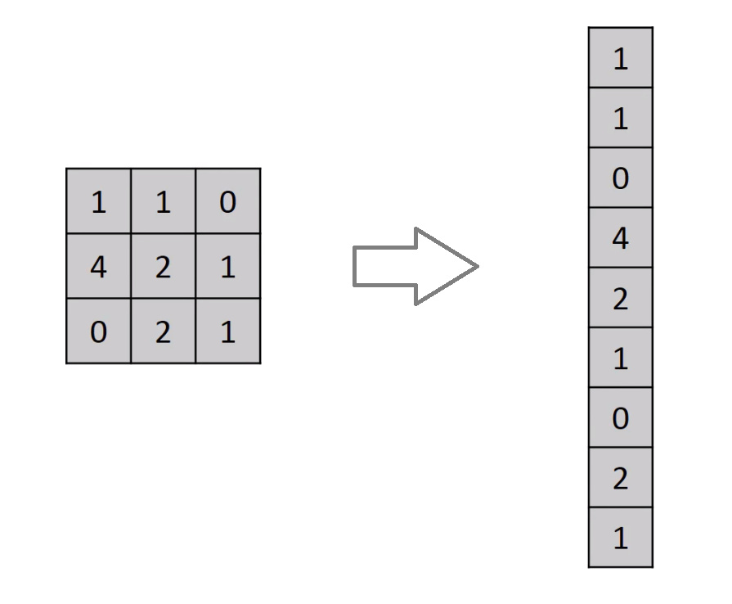
Neural Networks with Images

Slide 45

Neural Networks with Images – Dog example
“slightly” exaggerated

Slide 46
Convolutional Neural Networks

Slide 47
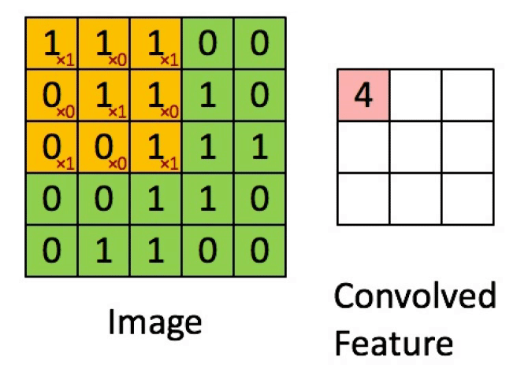

Convolutional Neural Network (CNN) Layers
Convolution
Extract features & Keep spatial relationship
Pooling/Subsampling
Reduce dimensionality & retain information
*Figure Courtesy: Erik Reppel
*Figure Courtesy: Cambridge Spark Ltd

Slide 48
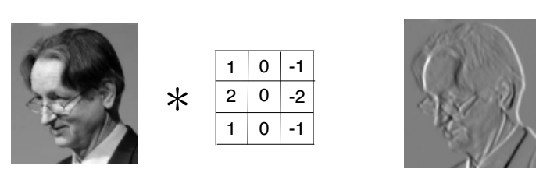
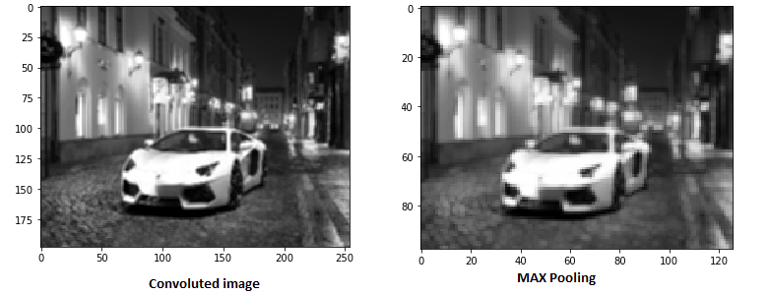
Convolution and max pooling layer on image
Convolution
Max Pooling
Source: https://leonardoaraujosantos.gitbook.io/artificial-inteligence/machine_learning/deep_learning/convolution | https://www.analyticsvidhya.com/blog/2017/06/architecture-of-convolutional-neural-networks-simplified-demystified/

Slide 49
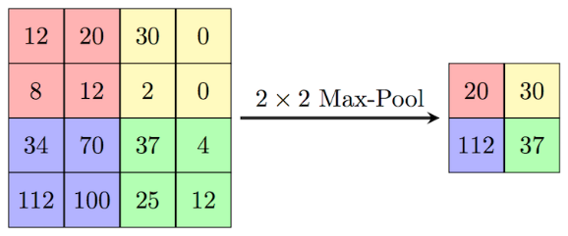
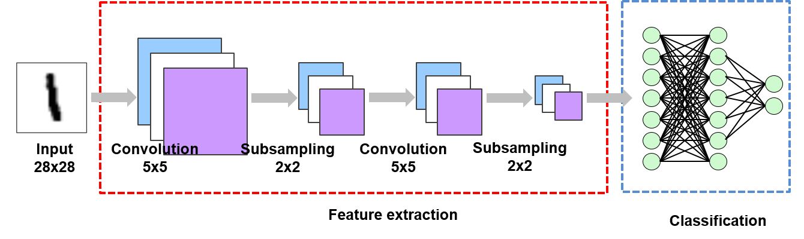



Example of CNN
Dog
Cat
*Figure Courtesy: Suhyun Kim iSystems Design Labs

Slide 50

NN vs CNN
Input: MNIST database
Neural Network Result:
97.8%
Convolution Neural Network Result:
99.07%

Slide 51
Hands on examples of Supervised Learning

Slide 52


Hands on examples with MNIST
Neural Network (MNIST)
Convolution Neural Network (MNIST)
Follow this link & install yourself : https://github.com/SavvasRaptis/machine-learning-examples
Or directly use: https://mybinder.org/v2/gh/SavvasRaptis/machine-learning-examples/HEAD

Slide 53
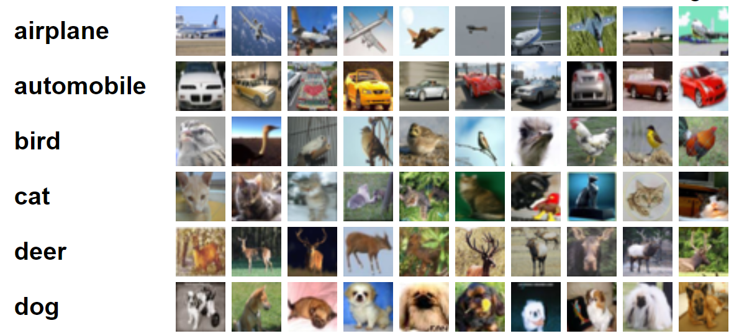
If MNIST is easy for you, check CIFAR-10

Slide 54

Can get harder!
https://www.kaggle.com/datasets/returnofsputnik/chihuahua-or-muffin
Notes:
Chihuahua or muffin

Slide 55
Supervised Learning in Space Physics

Slide 56
CME prediction example
(Classification problem)

Slide 57

Coronal Mass Ejections (CMEs)
CMEs
Energetic particles from the Sun
Problems in Satellites/Communications/Grids/infrastructures etc.

Slide 58




Project description
Input
$$[13,512,512]$$
Convolution Neural Network
Feature Extraction
Dense Neural Network
Classification
Output
CME / No CME
Conv
Conv
Conv
Pool
Conv
Conv
Conv
CME
$$…$$
$$…$$
No CME
Input = 13 SDO images, 2 [h] history before the event.
Output = 1/0

Slide 59

Result of CNN
Notes:
76.6% accuracy

Slide 60
Coronal Loop reconstruction example
(Regression problem)

Slide 61
Project description
Basic Properties
More easily seen in EUV & X-ray
More common in solar max
May be relevant to the coronal heating problem
Information
We see projections, therefore 2D can be observationally derived but 3D needs to be computed.
3D = vital for magnetic field extrapolation
There are many methods, but have limitations. [Aschwanden (2011), Chifu et al. (2017)]
See original publication: [Chifu & Gafeira 2021 ApJL]

Slide 62

Neural Network Architecture
X,Y, Z : Coordinates (1500 points each)
L : Length of the coronal Loop
D : Distance between footpoints
Θ : Angle defined by the two footpoints with the top of the loops

Slide 63


Results of the reconstruction
Predicted Coronal Loops
Actual Coronal Loops
See original results (Chifu & Gafeira 2021)

Slide 64
Magnetosheath jet classification
(Classification problem)

Slide 65


Magnetosheath jet
Definition
Magnetosheath jets are transient localized enhancements of dynamic pressure (density and/or velocity increase)
Classification
“$Θ_{Βn}$ is the angle between the IMF and the shock’s normal vector”
Qpar = $Θ_{Βn}≲{45}^{∘}$
Qperp = $Θ_{Βn}≳{45}^{∘}$
”~10 times more often in Qpar MSH”

Slide 66




Classification task
Quasi-Parallel
Bow Shock
Quasi-Perpendicular
The solar wind
Magnetopause
MMS
Jets
WIND
$$L_{1}$$
Classify with ML
Earth
ACE

Slide 67

Classifying jets with Neural Networks
Upstream
SW
L1 OMNI
Downstream
MSH
MMS
Raptis, Aminalragia-Giamini et al. (2020) | Front. Astron. Space Sci

Slide 68
Forecasting of DST index
(Regression problem)

Slide 69
Prediction of the Dst index
“average disturbance field at the Earth's equator from four low-latitude magnetic observatories”
The value of Dst along with its pattern (sharpness, duration, etc.) provide a profile for the geomagnetic storm
Recap questions
Why we call this a regression problem ??
What would a classification problem be here ?

Slide 70
https://github.com/SavvasRaptis/machine-learning-examples
Try for example:
t_fcast = 1
t_fcast = 3

Slide 71


Prediction of the Dst index
Output: DST index
(1 Hour later)
Input: Quantities from satellite ACE (L1)
4 Layers of (20, 10, 5, 1) Neurons
500 Epochs
Anything fishy ?? Is this a good prediction ??

Slide 72
Solar Energetic Particle Prediction
(Classification problem)

Slide 73



Solar Energetic Particles (SEPs) & Flares
Flares = X-ray emission
High energy proton flux
SEP
Notes:
Using GOES SXR data

Slide 74

Classes in real datasets
Question: In the examples we show before… how “balanced” was the dataset?
Notes:
Using GOES SXR data

Slide 75

Application on forescasting SEPs
Problem description
Modeling
Validation & Results
 | Predicted Yes | Predicted No
Actual Yes | TN | FP
Actual No | FN | TP
24 features
Occurrence of SEP based on X-rays of flares
Comparisons to other models recently published
Review of Solar Energetic Particle Models (Advances in Space Research)
Aminalragia-Giamini, Raptis et al. (2021) | J. Space Weather Space Clim
Notes:
Using GOES SXR data

Slide 76
https://github.com/SavvasRaptis/machine-learning-examples
Try for example:
50 epochs
300 epochs

Slide 77
Application on forescasting SEPs
Problem description
Modeling
Validation & Results
 | Predicted Yes | Predicted No
Actual Yes | TN | FP
Actual No | FN | TP
24 features
Occurrence of SEP based on X-rays of flares
Comparisons to other models recently published
Review of Solar Energetic Particle Models (Advances in Space Research)
Aminalragia-Giamini, Raptis et al. (2021) | J. Space Weather Space Clim
Notes:
Using GOES SXR data

Slide 78
Application on forescasting SEPs
Problem description
Modeling
Validation & Results
 | SEP predicted always YES | SEP predicted always NO
SEP occurred YES | 191/220 [86.81 %] | 19/220 [8.63%]
SEP occurred NO | [7.77 %] | [92.23%]
24 features
Occurrence of SEP based on X-rays of flares
Comparisons to other models recently published
Review of Solar Energetic Particle Models (Advances in Space Research)
Aminalragia-Giamini, Raptis et al. (2021) | J. Space Weather Space Clim
Notes:
Using GOES SXR data

Slide 79


Learn more on machine learning & space physics

Slide 80
Final notes
We only saw a small piece of the puzzle today. Applications in physics include:
Unsupervised learning (clustering of magnetospheric environments)
Reinforcement learning (optimize when and where to make observations with telescopes)
Physics – Informed Neural Networks (PINNS). (e.g., diffusion in radiation belts)
I will be more than glad to share information about these topics if you want to learn more & provide material.

Slide 81

Summary & Take-Home Message
Machine learning techniques are already used a lot in research, both in academia and in industry.
Things move very quickly, PINNs that I mentioned in the previous slide are just here for the last ~5 years and there are hundreds of articles on them already.
Abigail et al. (2020)

Slide 82
EXTRAS

Slide 83

Adaptive activation functions
TLDR: optimize the activation function $∀$ neurons during training = no hardcoded $a$
Jagtap, A. et. al (2020). Adaptive activation functions accelerate convergence in deep and physics-informed neural networks.

Slide 84

Why normalization is vital?
Raptis (2018) | KU Leuven

Slide 85

“Proven” to solve a vital problem in optimization
TLDR: Huge problem in traditional machine learning a few years ago = can be solved now
Kenji Kawaguchi et. al (2019)

Slide 86

Physics Informed Machine Learning
Usual case in certain fields (fluid mechanics, space, plasma, medicine etc.)
Notes:
PINNS tries to encode physics within the neural network framework
Also good to remind here the fundamental difference between CNNs that have implicitly baked architecture that for example respect symmetries. Here we explicitly impose constrain on the output of the traditional NNs . This is very different. Now you don’t need to create your own layer for your problem. You can simply impose the constrains at the end of your system rather than learning full machine learning.

Slide 87

What exactly is a PINN then ?
$$loss=data fit+PDE residual+ICs fit+BCs fit$$
Idea = If output is a differentiable quantity with respect to an input = can compute PDEs = combined loss functions
Notes:
u here is a function that satisfied a parametrized PDE. So you constrain the neural network through the physical laws you add. So we use the same backpropagation that we use in neural network and we simply add some constrains as part of the loss function.
In the loss function one can generally add any kind of constrain like that. For example, symmetries, Galilean constrains, etc. It’s a general form.
System is governed by PDE and the goal is to solve the PDE (forward problem)
We have a collection of data we may or may not know the PDE and we want to calibrate the terms (inverse problem)

Slide 88
2 type of problems
Data-driven solutions to partial differential equations
Burger’s equation
Schrodinger Equation
Data-driven discovery of nonlinear partial differential equations
3) Navier-Stokes Equation

Slide 89
Data-driven solutions
(forward problem)

Slide 90



Example 1 – Burger’s equation
Here we basically enforce initial and boundary conditions.
Penalty of points not satisfying f / residual loss
Notes:
We want to solve the burger’s equation (also known as the poor man’s model to study turbulence in 1D).
And we can simply do it with a neural network.
What you see here, is the points that you use (x) these are initial conditions and some random points for boundary conditions (x=1, x=-1) and there are also some random points around the grid that are not visible here. These were the training set
The whole plot is basically the predicted solution for the problem. So based on IC and BC data the physics informed regularization allowed us to get solution inside the domain.

Slide 91




Example 2 – Schrodinger equation
Same thing as we saw before (initial)
Basically enforcing the above conditions (boundary)
Penalty of points not satisfying f (residuals)
Notes:
Here we have the non-linear Schrodinger equation along with periodic boundary conditions.
In this example, we have h basically having u and v where there is a real and an imaginary part.
Network here was 5 layer with 100 neuron per layer.

Slide 92
Data-driven discoveries
(inverse problem)

Slide 93




Example 3 – Navier–Stokes equation (1)
Basically imposing boundary conditions
The system of differential equations
Also, continuity equation/divergence-free result:
Goal: Estimate $λ_{1,2}$ and $p\left(t,x,y\right)$
First step: Generate some data for steady state solution
Second step: minimize MSE to satisfy boundary conditions for $t≠0$ and the general PDE.
So basically we define the following system (f,g):
Notes:
Here we consider the 2D navier-stoke equation, describing incompressible fluid.
u is the velocity field in the x direction and v is the velocity field in the y direction
L1 and l2 are unknown parameters

Slide 94


Example 3 – Navier–Stokes equation (2)
5000 scattered data points
Training Data
2 Results
Stream wise and transverse velocity

Slide 95

Example 4 – Hidden Fluid Mechanics
Maziar Raissi et. al (2020) Science (https://science.sciencemag.org/content/367/6481/1026)
https://maziarraissi.github.io/research/09_hidden_fluid_mechanics/
Notes:
Train data : Movie of the flow in an artery. We have some “measurements” – Scalar properties at some specific special temporal points.
Goal: Can you infer what is the underline velocity & pressure field
Model: Employing PINNS, take x,t and then you output pressure, velocity. Now, you know that all these quantities are connected through the underlying physics, thew navier-stoke equation + advection equation.

Slide 96

Bayesian Physics Informed Neural Networks (B-PINNs)
TLDR: Noisy/Real data → Need uncertainty quantification → Bayesian approach is good → combine

Slide 97

Maybe we can see some examples ?

